Slide 1

The Box Revolution Is Here!
CONFIDENTIAL DO NOT DISTRIBUTE

Slide 2

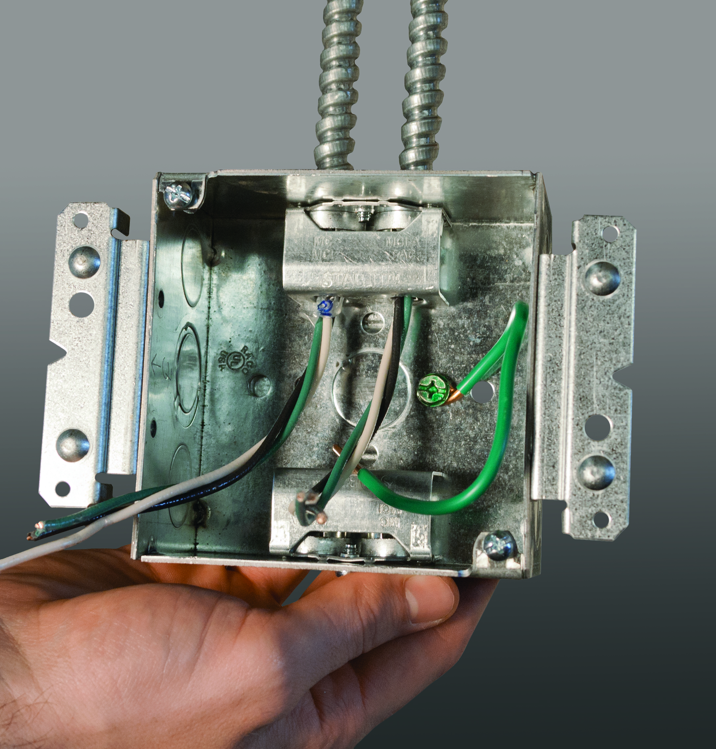
What is ?
RACO STAB-IT™ boxes revolutionize the way MC cable is inserted into a junction box
Only ALL-IN- ONE solution to terminate MC cable into a junction box
Patented MC cable connector
3 times faster than traditional connectors
CONFIDENTIAL DO NOT DISTRIBUTE

Slide 3
Need for ?
There are primarily 2 traditional methods of installing MC cable into a junction box. While each method has a purpose and application, they are both labor intensive and inefficient.
Method #1
Method #2
Box with built in cable clamp
Box with external connector fitting (push-in or screw in types)
CONFIDENTIAL DO NOT DISTRIBUTE

Slide 4
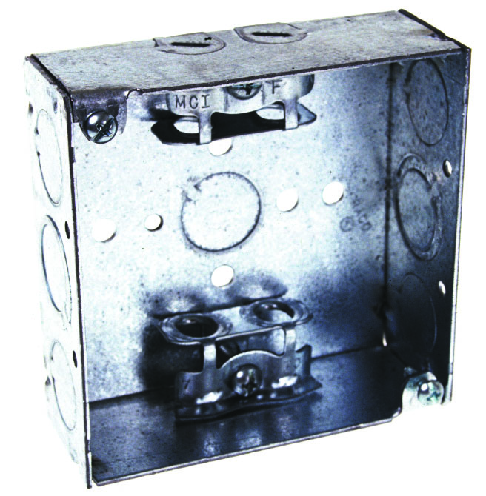
Method #1
Box w/Built in MC Cable Clamp
Oldest method of installing MC cable into a box
Costly to produce
Need to tighten clamp screw to secure cable in box
Only available with 2 clamps
Screws protrude from back of box – not conducive to prefab work or surface mounting
Difficult to tighten clamp screw to secure cable with mud ring installed
CONFIDENTIAL DO NOT DISTRIBUTE

Slide 5
Method #1
Box w/Built in MC Cable Clamp
Basic Steps to Install Cable:
Prepare end of cable(s)
Remove box from carton
Mount box to bracket
Remove pri-out(s)
Insert cable(s)
Tighten clamp(s)
CONFIDENTIAL DO NOT DISTRIBUTE

Slide 6
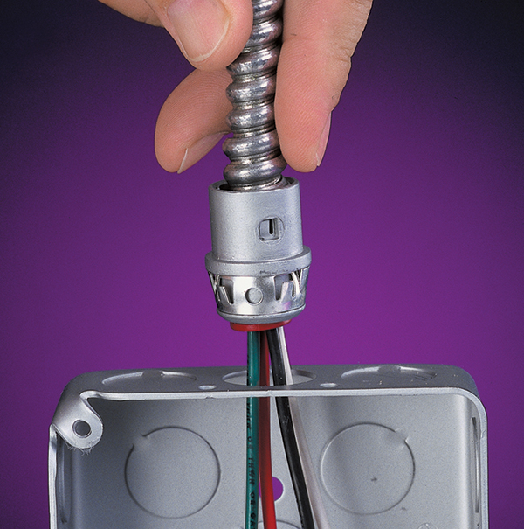
Method #2
Conduit Box with External Fitting
Widely accepted method to install MC cable into box
Multiple components needed
Difficult to uninstall connector
Must use a fitting for each piece of cable or an expensive connector
2 failure points
  1. Cable to the connector
  2. Connector to the box
Very versatile
CONFIDENTIAL DO NOT DISTRIBUTE

Slide 7
Method #2
Conduit Box with External Fitting
Basic Steps to Install Cable:
Prepare end of cable(s)
Remove box from carton
Mount box
Remove knockout(s) in box
Remove fitting(s) from carton
Affix fitting(s) on end of cable(s)
Insert fitting(s) into box
CONFIDENTIAL DO NOT DISTRIBUTE

Slide 8
Key Saving$ & Selling Points
3X Faster to Install!
Time tested and proven to be up to 3X faster per cable
Faster to install than traditional MC wiring methods using push-on/in die cast fittings
Less labor
Faster install means less labor which saves the contractor money. If using snap-in type fittings….the more cables into the box, the more labor and materials you are spending!
More time = more jobs
Reduced Transactional Costs
No longer need to order and inventory costly MC cable fittings separately from junction boxes
Fewer sku’s to manage on job and to inventory
Less Corrugated Waste on Jobsite or Shop
Elimination of fittings means less corrugated to manage and to dispose of and haul away
Better for the environment
Designed for Prefab OR Jobsite Use
CONFIDENTIAL DO NOT DISTRIBUTE

Slide 9
Types & Sizes Of Cables for
 | CABLE TYPES AND RANGES FOR STAB-IT™ CLAMP
 | CABLE TYPES |  | CABLE RANGES
 | AC STEEL & ALUMINUM |  | 14-2, 14-3, 14-4, 12-2, 12-3, 12-4, 10-2, 10-3
 | HCF AC STEEL |  | 14-2, 14-3, 14-4, 12-2, 12-3, 10-2, 10-3
 | HCF AC ALUMINUM |  | 12-2, 12-3, 12-4, 10-2, 10-3
 | MC STEEL & ALUMINUM |  | 14-2, 14-3, 14-4, 12-2, 12-3, 12-4, 10-2, 10-3
 | MCI-A STEEL & ALUMINUM |  | 14-2, 14-3, 14-4, 12-2, 12-3, 12-4, 10-2, 10-3
 | HCF MCI-A STEEL |  | 12-2, 12-3, 10-2
 | HCF MCI-A ALUMINUM |  | 14-2, 14-3, 14-4, 12-2, 12-3, 12-4, 10-2, 10-3
 | 3/8 TRADE SIZE FLEX. RWFMC CONDUIT STEEL & ALUMINUM
 | Per NEC: Anti Short Bushings Required on AC and FLEX conduit
 | CABLE RANGE .400" DIA. MIN. TO .605" DIA. MAX.
 | CABLE INSTALLATION
 | Cable Armor must comply with NEC 250.96
 | To remove cable, unscrew clamp from the box, then pull the clamp off the cable.
 | To install more cables, use any of the RACO® REDI-LOC connectors.
CONFIDENTIAL DO NOT DISTRIBUTE

Slide 10
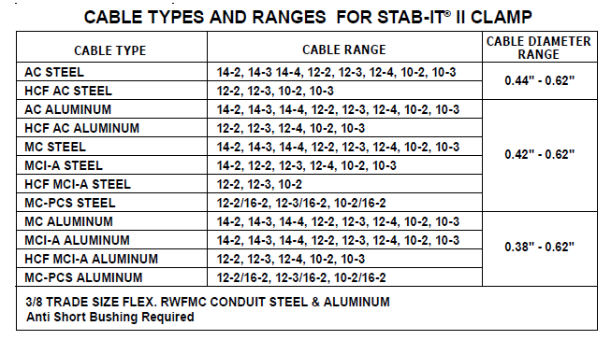
Types & Sizes Of Cables for STAB-IT® II

Slide 11
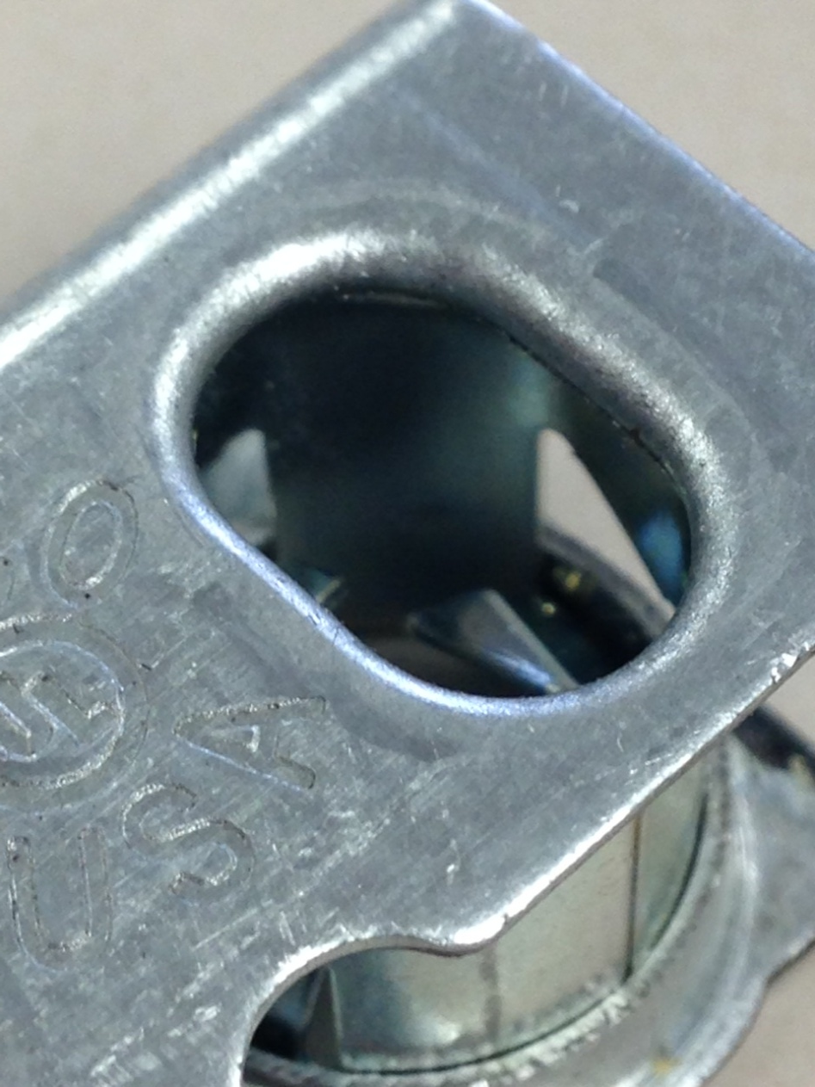
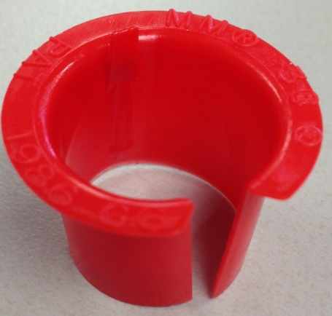
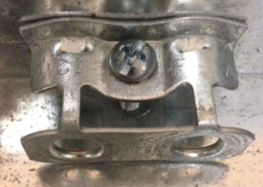
No “Red Hat” Needed
Formed smooth ferrule design allows for use with NO RED HAT
UL Listed for use without a RED HAT
Like Arlington fittings, RED HAT must be used with all AC Cable
CONFIDENTIAL DO NOT DISTRIBUTE

Slide 12
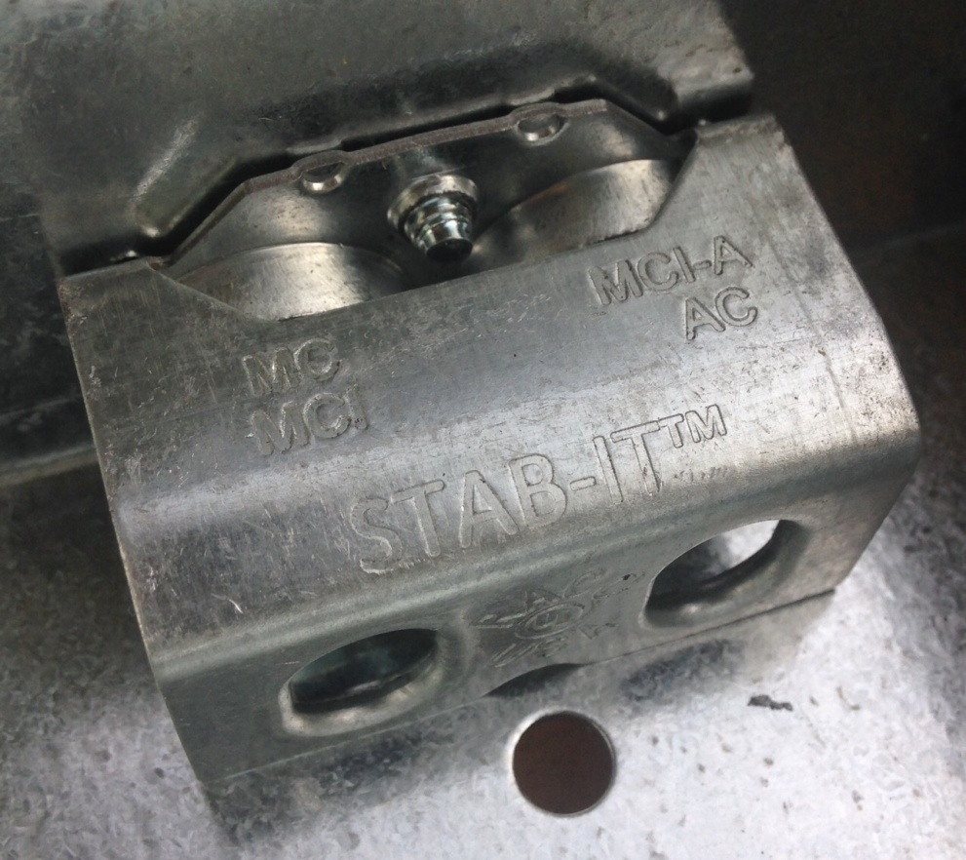
About the Connector
Counts as 1 deduction in box fill calculation
  No different than all other MC/BX clamps in a box
Has been tested with multiple brands and styles of wiring devices for clearance in the box
Listed with the most popular styles and sizes of MC cables
CONFIDENTIAL DO NOT DISTRIBUTE

Slide 13
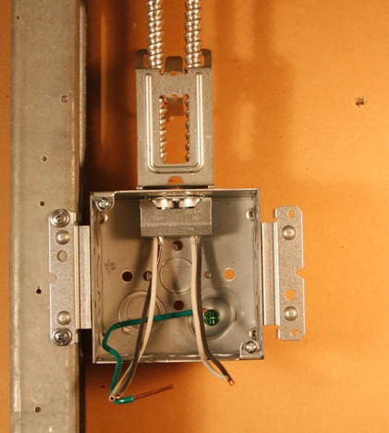
Built-in Cable Management Clip
Provides First Means of Support for cable leaving the box
Clip simply folds up out of the box towards the cable and quickly secures them.
Eliminates the need of an extra component to purchase (Caddy CJ6 among others)
Available on four (4) STAB-IT II Boxes.
  232SCM,232MSCM, 244SCM, and 244MSCM
CONFIDENTIAL DO NOT DISTRIBUTE

Slide 14
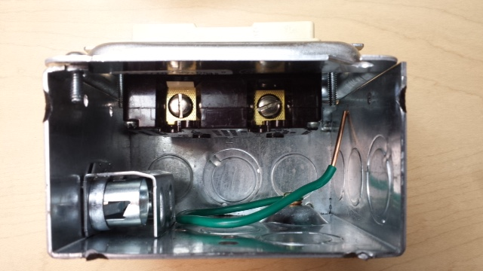
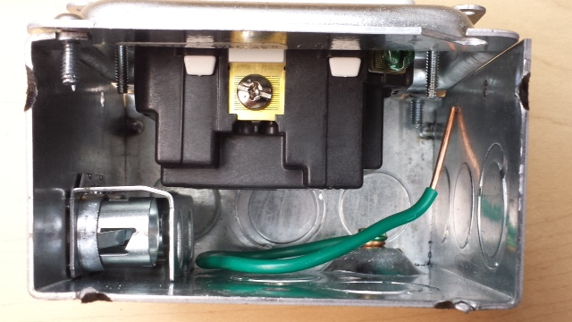
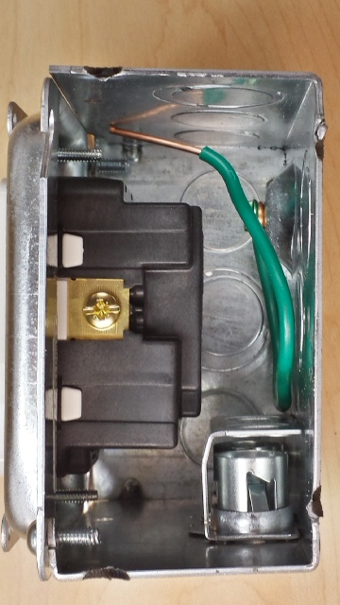
About the Connector
Fit tested with the L A R G E S T devices and ½” mud ring
CONFIDENTIAL DO NOT DISTRIBUTE

Slide 15
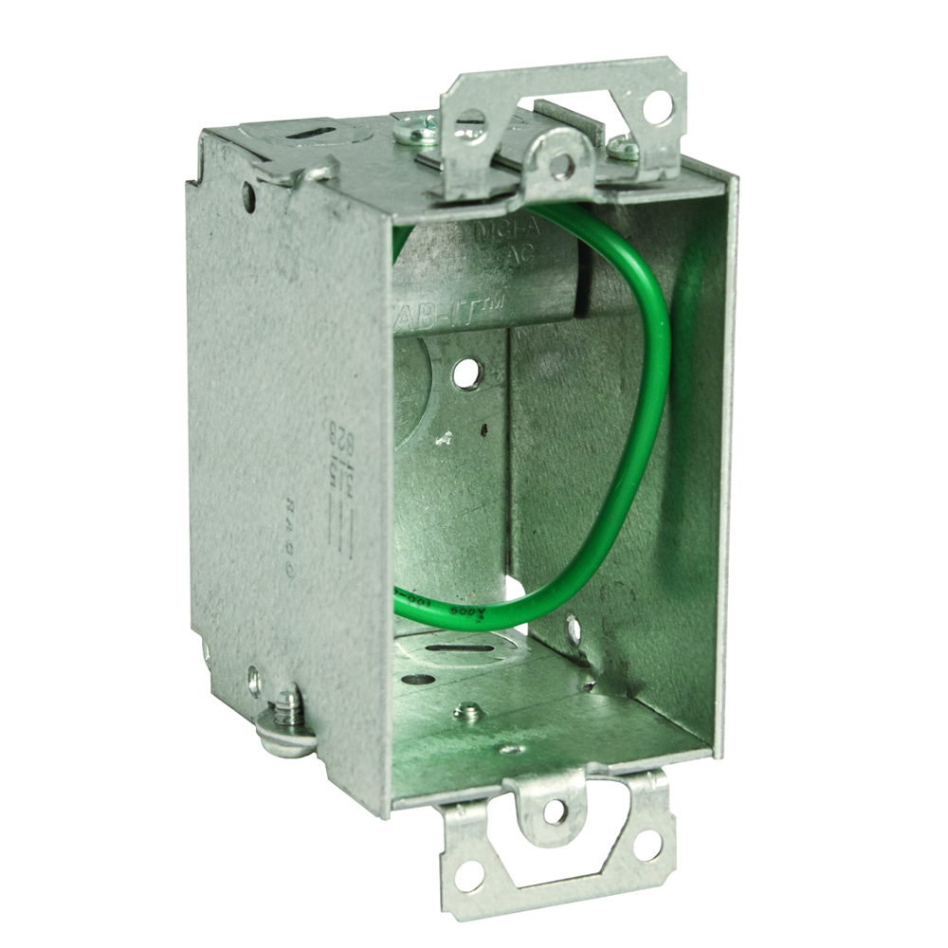
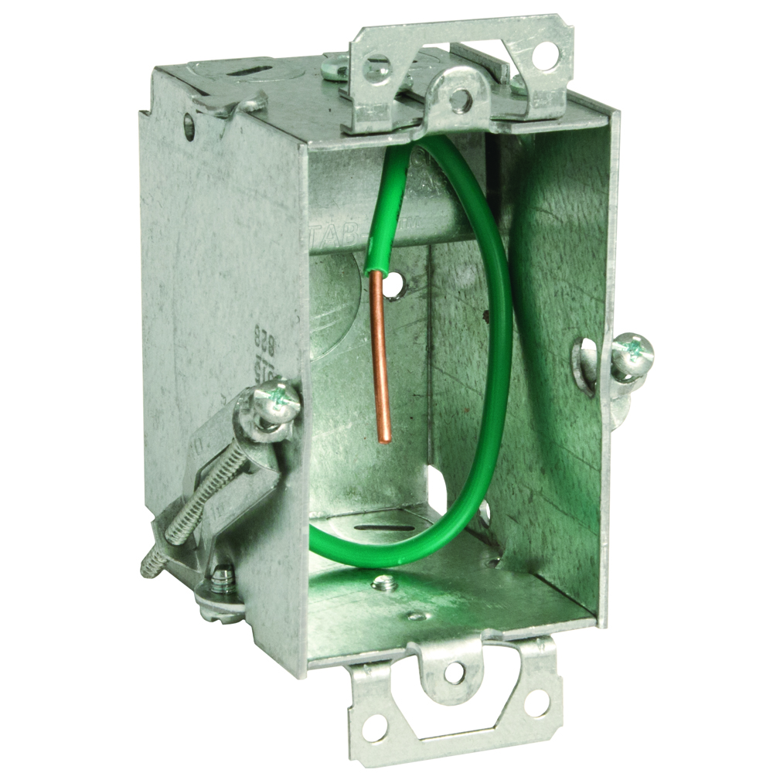
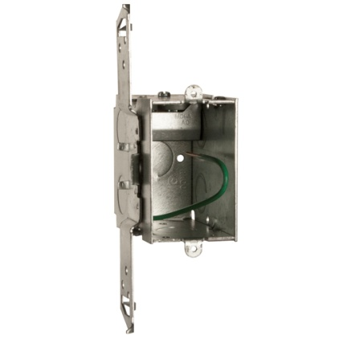
3” x 2” Switch Boxes
6 Sku’s Total:
  518S (1 Connector, 2 Cables) 2-1/2”DP
  523S (1 Connector, 2 Cables) 2-1/2” DP
  524S (1 Connector, 2 Cables) 2-1/2” DP
  618S (1 Connector, 2 Cables) 3-1/2” DP
  623S (1 Connector, 2 Cables) 3-1/2” DP
  624S (1 Connector, 2 Cables) 3-1/2” DP
With/Without Bracket
1 STAB-IT Connector each
Perfect for old work or new work applications when running MC cable
518S
523S
624S
CONFIDENTIAL DO NOT DISTRIBUTE

Slide 16
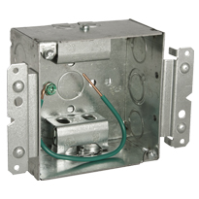
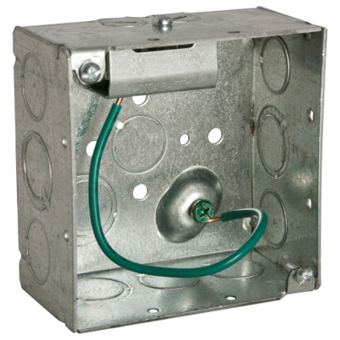
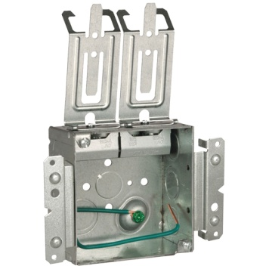
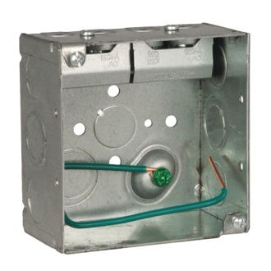
4” Square Boxes
11 Sku’s Total:
  232S (1 Connector, 2 Cables)
  232MS (1 Connector, 2 Cables)
  248S (2 Connectors, 4 Cables)
  248MS (2 Connectors, 4 Cables)
  248HS (2 Connectors, 4 Cables)
  232SCM (1 Connector, 2 Cables, First Means of Support Clip)
  232MSCM (1 Connector, 2 Cables, First Means of Support Clip)
  244S (2 Connectors, 4 Cables)
  244MS (2 Connectors, 4 Cables)
  244SCM (2 Connectors, 4 Cables, First means of support)
  244MSCM (2 Connectors, 4 Cables, First means of Support)
All 2-1/8” Deep
With/Without H or M-Bracket
1 or 2 STAB-IT™ Clamps
232S
248MS
244MSCM
244S
232SCM
CONFIDENTIAL DO NOT DISTRIBUTE

Slide 17
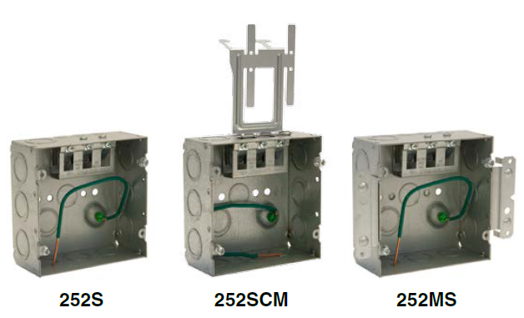
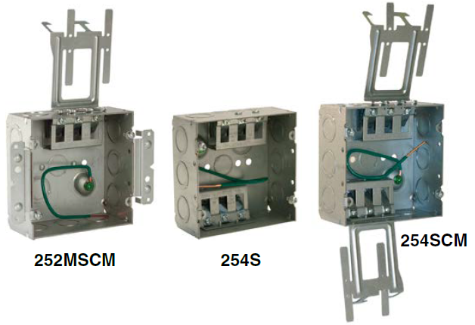
STAB-IT® II 4-11/16” Square Boxes
6 Sku’s Total:
  252S (1 Connector, 3 Cables)
  252SCM (1 Connector, 3 Cables, First Means of Support Clip)
  252MS (1 Connector, 3 Cables, M Bracket, Far side Support)
  252MSCM (1 Connector, 3 Cables, M Bracket, First Means of Support Clip, Far )
  254S (2 Connectors, 6 Cables)
  254SCM (2 Connectors, 6 Cables, 2 First Means of Support Clip)
All 2-1/8” Deep
All Include Pigtail
With/Without M-Bracket
Accepts larger cables including MC-PCS luminaire cable
1 or 2 STAB-IT II™ Clamps
Eccentric knockout on same side of box as connector

Slide 18
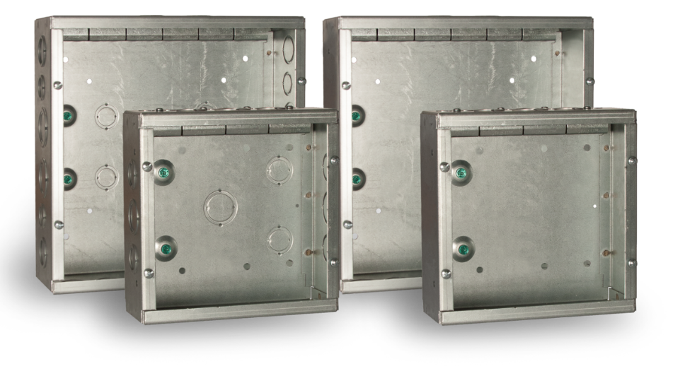
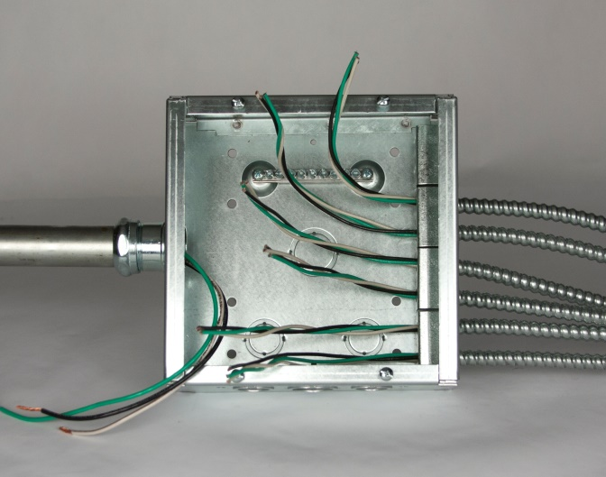
GRANDSLAM
Quickest and easiest way to terminate home runs and other electrical wiring
7 Sku’s Total:
  SC080803STRC (4 Connectors, 8 Cables, 12 concentric ½” & ¾” knockouts, 5 concentric ¾”&1” knockouts)
  SC121204STRC (6 Connectors, 12 Cables, 12 concentric ½” & ¾” knockouts, 9 concentric ¾”& 1” knockouts, 8 concentric 1”& 11/4” knockouts)
  SC080803NKSTRC (4 Connectors, 8 Cables)
  SC121204NKSTRC (6 Connectors, 12 Cables)
  SCF0808RC (Flush Mount Cover)
  SCF1212RC (Flush Mount Cover)
  989ST STAB-IT Connector
Available with Knockouts and without Knockouts
Includes ground bar
Includes surface mount cover
Two raised grounds for installation flexibility
989ST

Slide 19
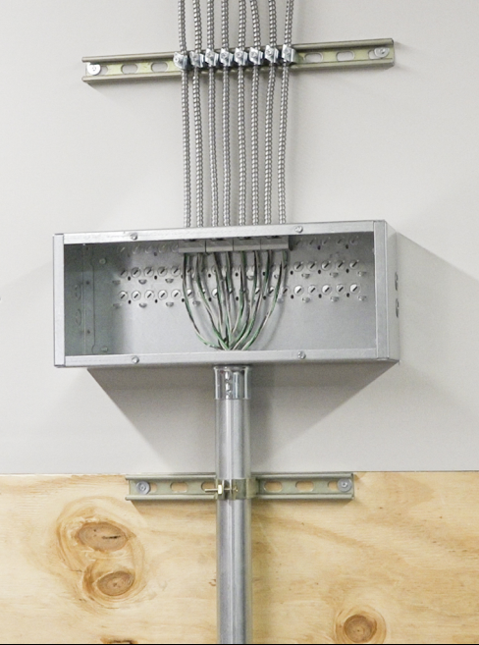
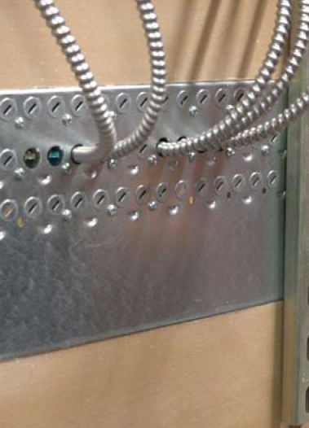
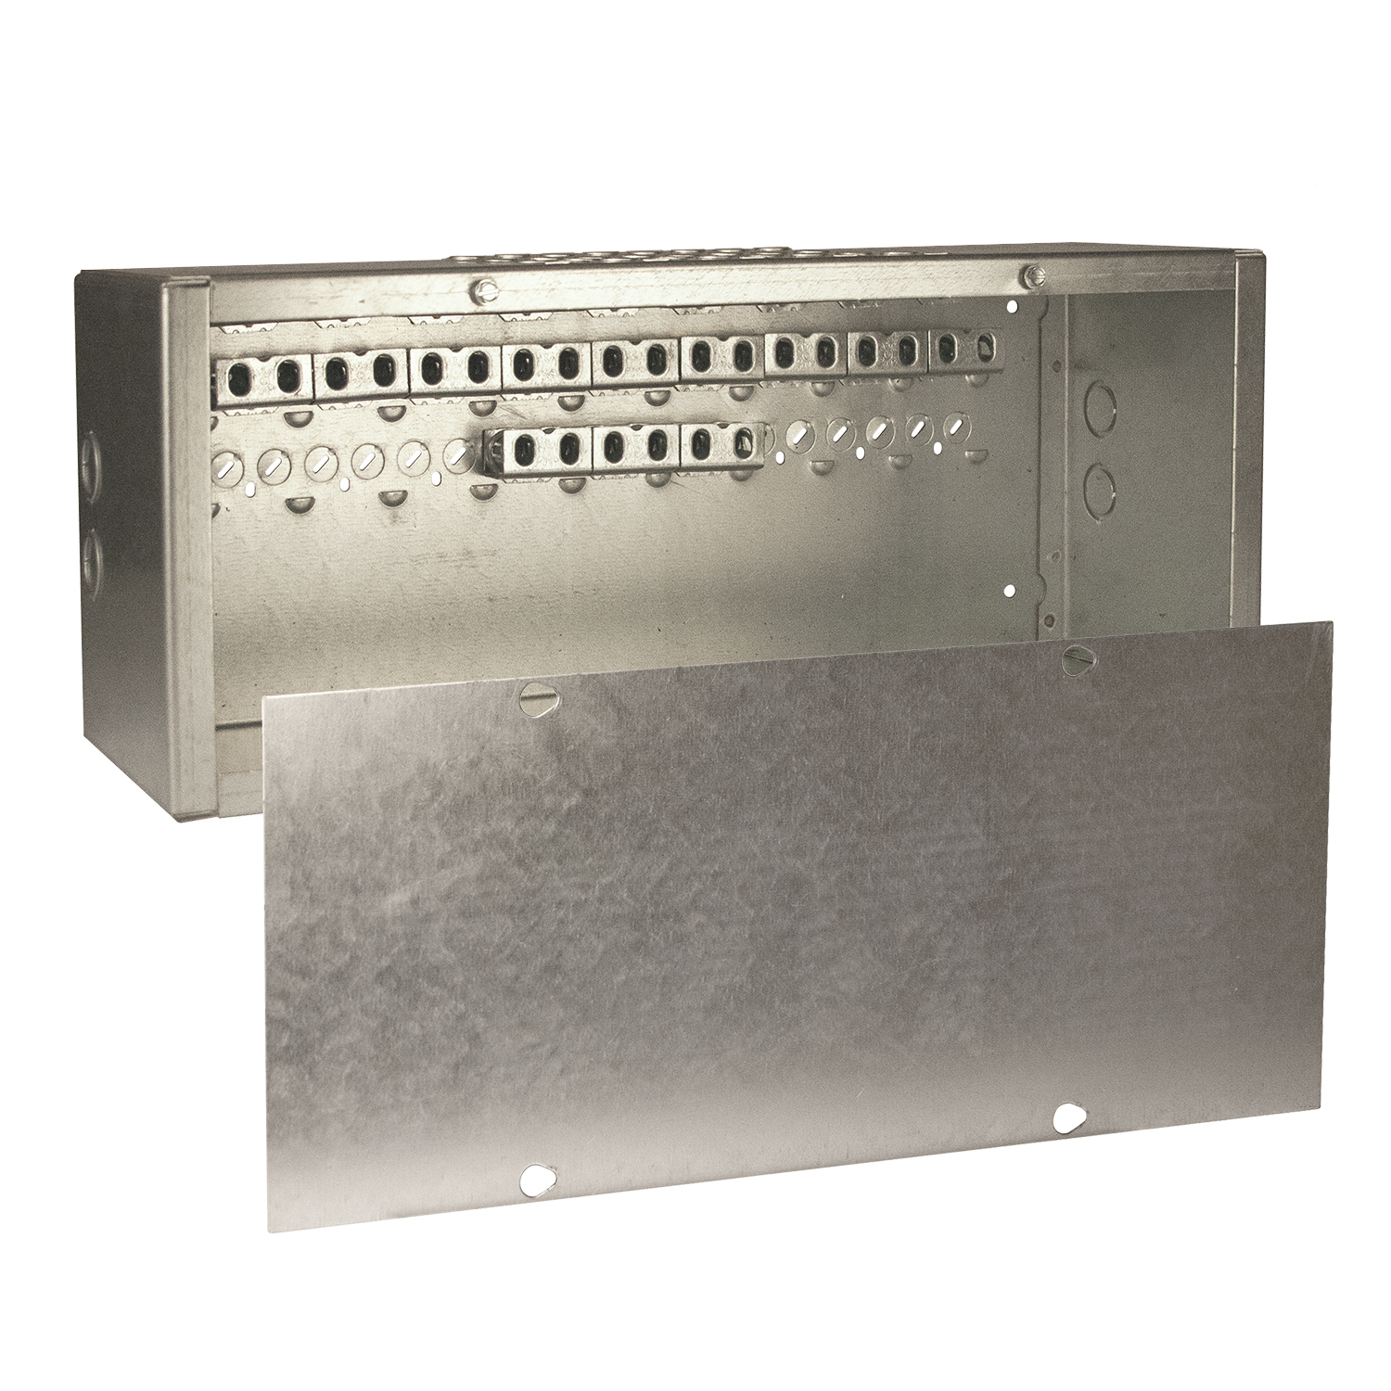
DUGOUT
Available May 2020
Quickest and easiest way to transition from flexible armored cable to conduit before entering the distribution panel
1 SKU:
  SC0082006STRC (21 Connectors, 42 Cables, 4 concentric ¾”&1” knockouts)
Pryouts on top and back for multiple applications
Cover includes
2 knockouts on each side

Slide 20

Online Videos
https://www.hubbell.com//raco/en/Videos
STAB-IT® https://www.youtube.com/watch?v=c_rd_MyusBI#action=share
STAB-IT® II https://www.youtube.com/watch?v=64KhqnjsdSQ&feature=youtu.be
Grandslam https://www.youtube.com/watch?v=c_rd_MyusBI&feature=youtu.be
STAB-IT® vs Competition - https://www.youtube.com/watch?v=FlYORAM_KLo&feature=youtu.be
Dugout – Coming soon

Slide 21
Questions?
NEW PRODUCT LAUNCH - CONFIDENTIAL

